Slide 1


NQueens Solver Visualizer
Name: Sumit Gupta
Reg. no.:12224034

Slide 2
NQueens Solver Visualizer
The N-Queens Solver Visualizer is a sophisticated Java application developed to provide both a practical solution to the N-Queens problem and a visual educational tool. The N-Queens problem is a well-known challenge in computer science and mathematics, requiring the placement of N queens on an N×N chessboard so that no two queens threaten each other. This application not only solves the problem but also offers a dynamic and interactive visual representation of the algorithm’s progress.

Slide 3

Project Overview
The N-Queens Solver Visualizer is a sophisticated Java application developed to provide both a practical solution to the N-Queens problem and a visual educational tool. The N-Queens problem is a well-known challenge in computer science and mathematics, requiring the placement of N queens on an N×N chessboard so that no two queens threaten each other. This application not only solves the problem but also offers a dynamic and interactive visual representation of the algorithm’s progress.
Practical Solution
Visual Educational Tool
Dynamic Visualization
The application provides a practical solution to the N-Queens problem, allowing users to find valid placements of queens on a chessboard of any size.
The application offers a dynamic and interactive visual representation of the algorithm's progress, making it easier to understand how the algorithm works.
The application serves as a visual educational tool, demonstrating the backtracking algorithm and its application in solving the N-Queens problem.

Slide 4

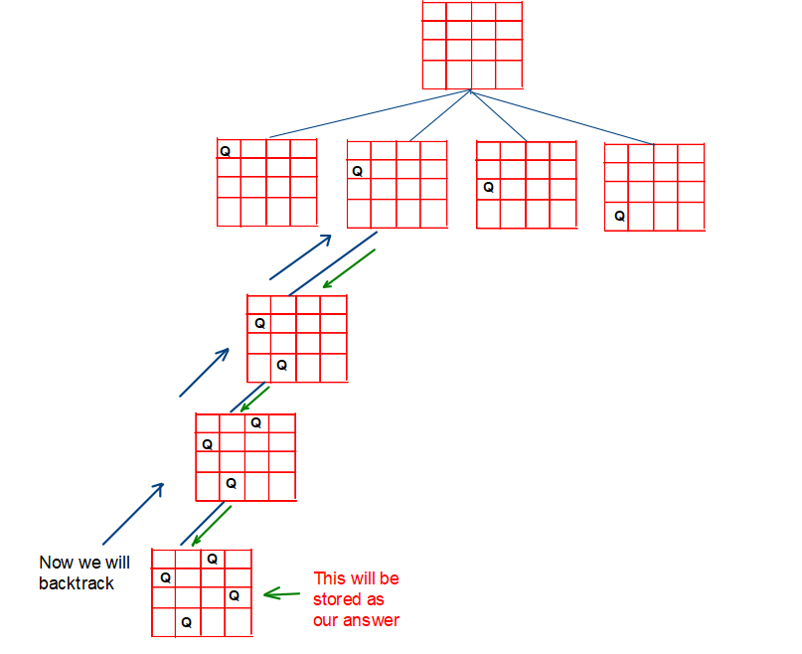
Algorithmic Demonstration
At the heart of this project is the backtracking algorithm, a fundamental technique in algorithm design used for solving constraint satisfaction problems. The backtracking algorithm is particularly suited for the N-Queens problem due to its ability to incrementally build candidates to the solutions and backtrack as soon as it determines that the current candidate cannot possibly lead to a valid solution.
1
Place a Queen
The algorithm attempts to place a queen in the first column of the first row.
2
Check for Conflicts
The algorithm checks if the placement of the queen creates a conflict with any other queens already placed on the board.
3
Backtrack if Necessary
If a conflict is detected, the algorithm backtracks to the previous row and tries a different column.
4
Repeat
The algorithm continues to place queens, check for conflicts, and backtrack until a solution is found or all possible placements have been explored.

Slide 5

Interactive Visualization
One of the most compelling features of the N-Queens Solver Visualizer is its interactive visualization. The real-time updates to the board allow users to follow along as the algorithm works through the problem. This interactive component transforms a static problem into a dynamic learning experience, making it much more engaging and informative.
1
Color Coding
2
Real-time Updates
3
Dynamic Input
The visualization uses color coding to indicate different stages of the algorithm. For instance, when a queen is placed on the board, the corresponding cell is highlighted in red.
The board is updated in real-time as the algorithm progresses, allowing users to see the algorithm's decision-making process.
Users can dynamically input the size of the board through a user interface element like a dialog box, allowing them to experiment with various configurations.

Slide 6
Project Objectives
The project aims to achieve the following objectives:
Develop a GUI-based application using Java Swing.
Implement the backtracking algorithm to solve the N-Queens problem for any given board size.
Visualize the solving process in real-time, updating the GUI to reflect the current state of the board.
Provide user interaction, allowing users to input the size of the board dynamically.
Ensure educational value by making the application intuitive and informative for educational purposes.

Slide 7

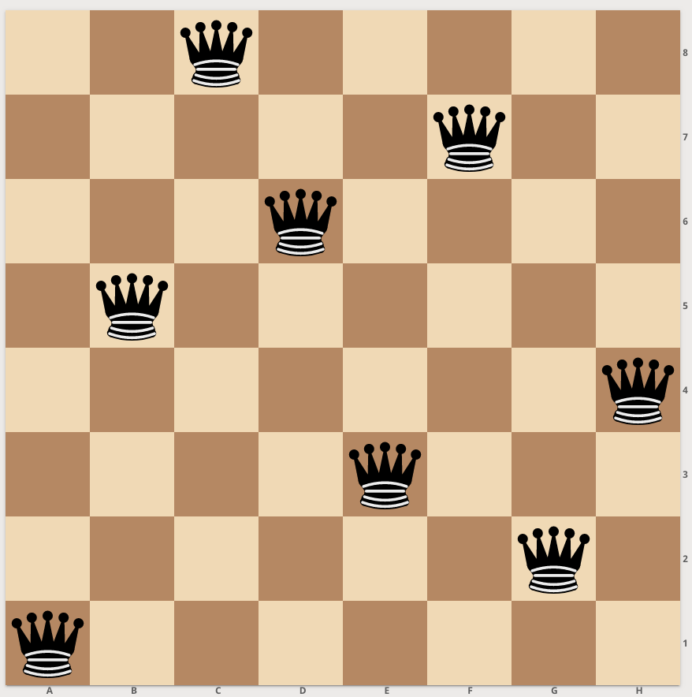
Background: The N-Queens Problem
The N-Queens problem is a classic combinatorial problem in computer science and mathematics. It involves placing N queens on an N×N chessboard such that no two queens threaten each other. This means:
No two queens can be in the same row.
No two queens can be in the same column.
No two queens can be on the same diagonal.

Slide 8
Importance and Applications
The N-Queens problem is not just a puzzle but also a benchmark for algorithms in constraint satisfaction, combinatorial optimization, and artificial intelligence. Solutions to the N-Queens problem help in understanding more complex problems in various fields such as:
Robotics
Parallel Processing
Cryptography
Pathfinding and positioning of robots.
Task scheduling without conflicts.
Generating secure keys through combinatorial principles.

Slide 9





Methodology
The project utilizes a combination of GUI design, algorithm implementation, and visualization techniques to achieve its objectives.
GUI Design
The graphical user interface is designed using Java Swing, with components like JPanel for drawing the chessboard and JFrame for handling user interactions.
Backtracking Algorithm
The backtracking algorithm is implemented in the solve method, which attempts to place queens row by row, checking for safety and backtracking if necessary.
Real-time Visualization
The application achieves real-time visualization by repainting the board after each attempt to place or remove a queen, introducing delays using Thread.sleep(DELAY) to slow down the visualization for better observation.
User Interaction
The application prompts the user to input the size of the board (n) using a dialog box, allowing for dynamic adjustment of the board size.

Slide 10




Implementation
The code structure consists of the NQueensSolverVisualizer class, which contains variables like queens (array to hold queen positions), n (board size), CELL_SIZE (cell size in pixels), and DELAY (delay for visualization). The class also includes methods for solving the problem, checking for safety, repainting the board, printing solutions, and handling user input.
Code Structure
The code structure consists of the NQueensSolverVisualizer class, which contains variables like queens (array to hold queen positions), n (board size), CELL_SIZE (cell size in pixels), and DELAY (delay for visualization).
Methods
The class also includes methods for solving the problem, checking for safety, repainting the board, printing solutions, and handling user input.

Slide 11
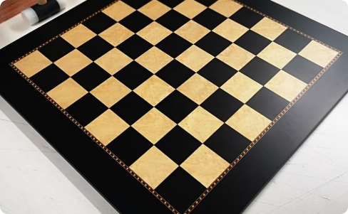
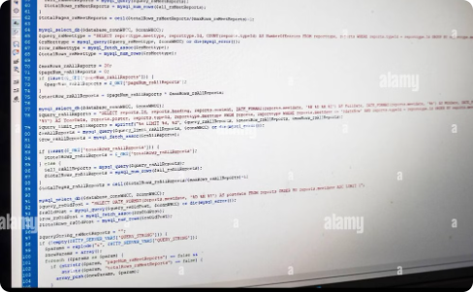

Educational Value
The N-Queens Solver Visualizer provides significant educational value by demonstrating algorithms, enabling interactive learning, and providing visual feedback. It helps students understand the backtracking algorithm and its application in solving the N-Queens problem.
Demonstrating Algorithms
Interactive Learning
Visual Feedback
The interactive nature of the application allows users to experiment with different board sizes and see the immediate impact on the solving process.
The real-time visualization helps in understanding how algorithms progress and handle constraints, which is often abstract in theoretical learning.
The application vividly demonstrates the backtracking algorithm, making it easier for students to grasp the concept.

